Slide 1
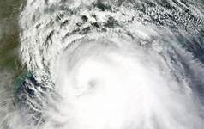

Galveston Hurricane
By Rachel Beatty

Slide 2
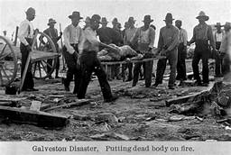
Overview
08/27/1900 to 09/15/1900.
6,000 and 12,000 people deaths.
chief weather expert.
Warning came late.
More serious.

Slide 3
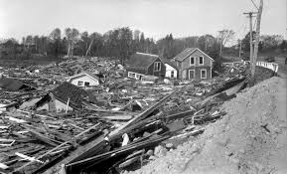
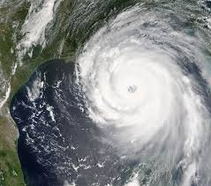
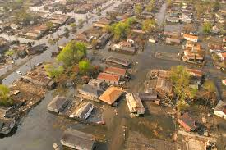
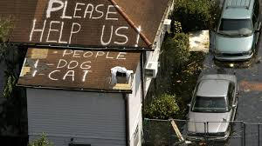
Hurricanes Since Galveston
More hurricanes since 1900
“Long Island Express.”
Hurricane Katrina.
Government’s response.

Slide 4
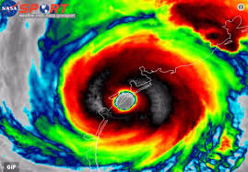
Why I Chose It
changed attitudes.
I love learning.
a few good sources.

Slide 5
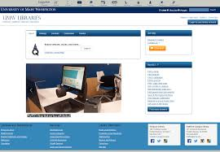
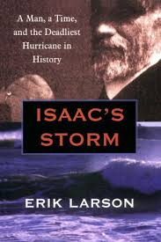
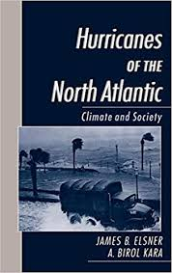
How I Found Sources
UMW Libraries.
Subject Encyclopedias.
Books.
Academic Search Complete.

Slide 6

What I Would Have Done
more research.
More Subject headings.
More encyclopedias.
books.
WORLDCAT and academic search complete.

Slide 7
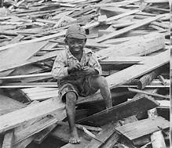
References
https://www.history.com/news/how-the-galveston-hurricane-of-1900-became-the-deadliest-u-s-natural-disaster
http://search.ebscohost.com.umw.idm.oclc.org/login.aspx?direct=true&db=a9h&AN=3081961&site=ehost-live
https://umw.idm.oclc.org/login?url=https://search-proquest-com.umw.idm.oclc.org/docview/198548379?accountid=12299
Elsner, James B., and A. Birol. Kara. Hurricanes of the North Atlantic Climate and Society. New York: Oxford University Press, 1999.
Larson, Erik. Isaac's Storm: A Man, a Time, and the Deadliest Hurricane in History. 1st Vintage Books ed. New York: Vintage Books, 2000.
http://web.a.ebscohost.com.umw.idm.oclc.org/ehost/search/advanced?vid=0&sid=fb1c0988-615c-4d72-9813-a2b4c21f04b5%40sdc-v-sessmgr03

