Slide 1

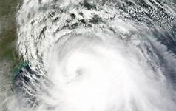
Galveston Hurricane
By Rachel Beatty

Slide 2
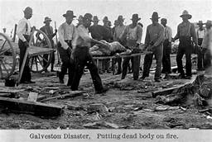
Overview
THE GALVESTON HURRICANE, ALSO KNOWN AS ISAAC’S STORM, LANDED IN GALVESTON AS A CATEGORY 4 HURRICANE ON SEPTEMBER 8, 1900 AND CAUSED MAJOR FLOODING AND DEVASTATION TO THE CITY OF GALVESTON OFF THE SOUTHERN TEXAS COAST, KILLING AN ESTIMATED 6,000-12,000 PEOPLE ACCORDING TO NOAA AND CAUSING $30 MILLION (1900) IN PROPERTY DAMAGES. IT WAS NAMED ISAAC’S STORM AFTER METEOROLOGIST ISAAC CLINE, A RESIDENT WHO ATTEMPTED TO WARN CITY AUTHORITIES IN GALVESTON ABOUT THE STORM, BUT AT THE TIME, ONLY THE WEATHER BUREAU IN D.C. HAD THE AUTHORITY TO ALLOW METEOROLOGISTS TO ISSUE STORM WARNINGS, AND DUE TO POOR COMMUNICATION, THE CITY HAD NO WARNING, ISAAC’S WIFE WAS KILLED, AND GALVESTON NEVER FULLY RECOVERED. THE STORM BROUGHT A SEA CHANGE IN HOW HURRICANES ARE HANDLED IN THE UNITED STATES, CONVINCING CIVIL AUTHORITIES THAT BETTER COMMUNICATION AND PROVIDING ACCURATE FORECASTS WAS CRITICAL TO PREVENTING LOSS OF LIFE.

Slide 3
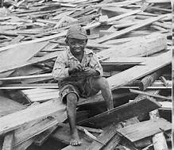
Why I Chose It
I chose this topic because this hurricane changed everything for the United States in terms of how seriously American meteorologists and civil authorities regard hurricanes and other destructive natural events as significant threats to life, property, and livelihood. I have always been interested in weather and the natural sciences since childhood and I enjoy learning how things function in order to improve human quality of life. I have an interest in disasters that bring significant changes to America’s culture and understanding of nature as far as their effects on society (race, SES, etc.), the economy (small businesses, trade by sea and air, tourism, etc.), and the government’s ability to adequately respond to them (rebuilding and recovery). Though it was a little tricky, I found a diversity of sources on the Galveston hurricane using the UMW Library’s website.

Slide 4

How I Found Sources
I found a variety of sources on the disaster using the subject encyclopedias found on UMW Library’s website, ranging from journal articles to books. The subject encyclopedias pertain mainly to American history and the history of disasters, such as the Encyclopedia of American History and Disasters and Tragic Events: An Encyclopedia of Catastrophes in American History. Some of the helpful subject headings are “Galveston Hurricane,” “Disasters America,” and “Hurricanes.” A few of the secondary sources found on the topic using the encyclopedias and Quest are “Hurricanes of the North Atlantic Climate and Society by James B. Elsner,” “Galveston by Fannie May Gibbes, Christian Observer (1840-1910), Oct 17, 1900, Vol.88(42), p.6,” and “Galveston Disaster by M.H. Zahner.” However, I think I need to find some more book sources on the Galveston Hurricane.

Slide 5

What’s Left For Me To Do
I still have some more research to do on the historiography of the Galveston Hurricane. The subject encyclopedias gave me few sources which I believed to be suitable. For example, the subject heading “Galveston Hurricane” sometimes returned results such as articles and a few books pertaining to Hurricane Ike’s impact on the city as well as the issue of pollution. It was also quite difficult to find very many subject encyclopedias for disasters and the Encyclopedia of American History and Disasters and Tragic Events: An Encyclopedia of Catastrophes in American History were the only ones that were remotely related to disasters, so I believe these two will provide the most useful information. In addition, I will attempt to locate more books on the Galveston Hurricane, which I believe can be achieved through searching WORLDCAT and Google.

Slide 6
References
https://www.history.com/news/how-the-galveston-hurricane-of-1900-became-the-deadliest-u-s-natural-disaster

